Slide 1
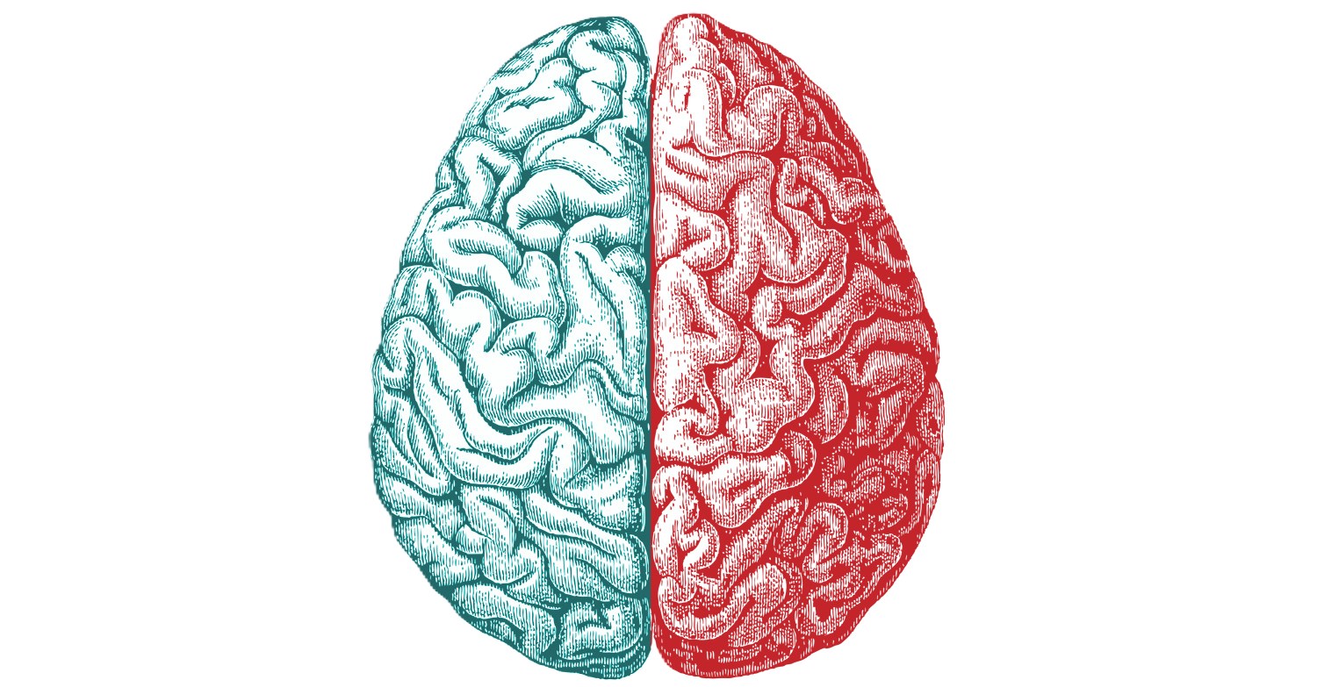
Discoveries concerning the cerebral hemispheres and information processing in the visual system
Robin Herberich
Maguette Diouf
April 2024

Slide 2
Index
Introduction
Functional specialization of the cerebral hemispheres
Main experiment
Implications
Information processing in the visual system
Main experiment
Implications
Conclusion

Slide 3
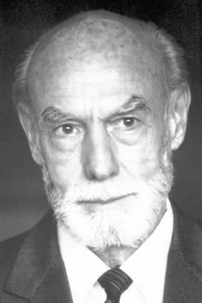
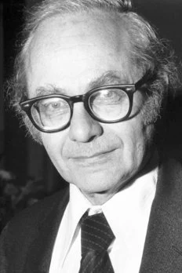
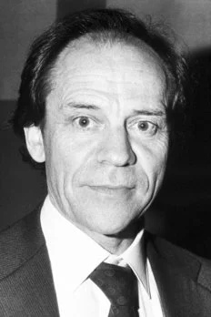
Nobel Prize in Physiology or Medicine 1981
Adapted from the Nobel Prize fact sheet
Roger W. Sperry
Adapted from the Nobel Prize fact sheet
David H. Hubel
Adapted from the Nobel Prize fact sheet
Torsten N. Wiesel
Discoveries concerning the functional specialization of the cerebral hemispheres
Discoveries concerning information processing in the visual system
Notes:
Roger got half, the others got half jointly

Slide 4
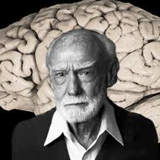
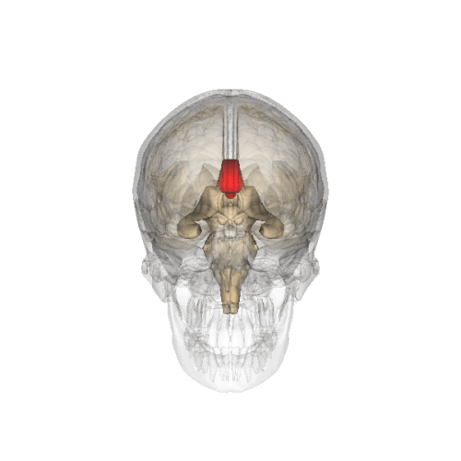
Functional specialization of the cerebral hemispheres
What was known before the experiments :
The two hemispheres generally perform different functions.
Left brain hemisphere considered as the dominant one (center of speech).
Roger Sperry : experiments on monkeys and epileptic patients with severed brain hemispheres connection (through commissurotomy).
Discovery : each cerebral hemisphere retains its ability to learn, but what is learned by one hemisphere is not accessible to the other
Success in extracting the secrets from both hemispheres (highly specialized) and demonstrating many higher functions are centered in the right hemisphere.

Slide 5
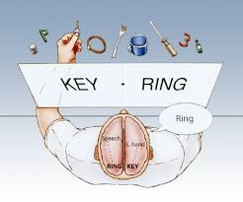
Sperry's Split-brain experiment
Approach
Set-Up :
"Split-brain" patient in front of a screen that would hide their hands.
Objects placed behind the screen
A word appears on the screen in the patient’s left visual field (processing in the right hemisphere)
The test :
Say what they saw
Use of left hand to pick the right object
Result :
Patient unable to tell the word that they had seen but able to choose the correct object
Notes:
Explication du procédé (en surface mais compréhensible dans l'ensemble) see maybe video + quizlet

Slide 6
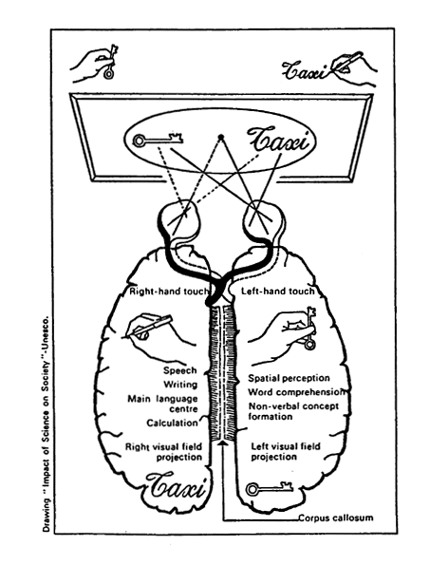
Conclusion
Right Brain Dominance :
Expressing and reading emotions
Understanding metaphors
Discriminating shapes
Copying designs
Making music
Left Brain Dominance :
Language
Critical thinking
Logic
Reasoning
Use of numbers (calculation...)
"Muteness" of right hemisphere made it inaccessible --> Consequence : considered as being entirely subordinate to the left hemisphere.
Sperry revealed that the right hemisphere is clearly superior to the left hemisphere in many respects.
He provided insight into the inner world of the brain and a new dimension in the comprehension of the higher functions of the brain.

Slide 7
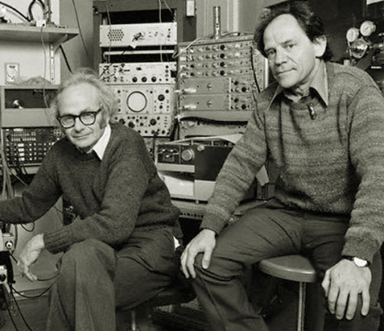
information processing in the visual system
They sought to understand how the brain takes simple information from the eyes and transforms it into our complex visual perception of the world.
Hubel and Wiesel mainly experimented with kittens
https://definingmomentscanada.ca/wp-content/uploads/2022/09/img_EP_hubel-weisel-toys2.jpg
Notes:
They sought to understand how the brain takes simple information from the eyes and transforms it into our complex visual perception of the world.
Hubel and Wiesel’s experiments with kittens showed that there is a critical period during which the visual system develops in mammals, and it also showed that any impairment of that system during that time will affect the lifelong vision of a mammal.

Slide 8
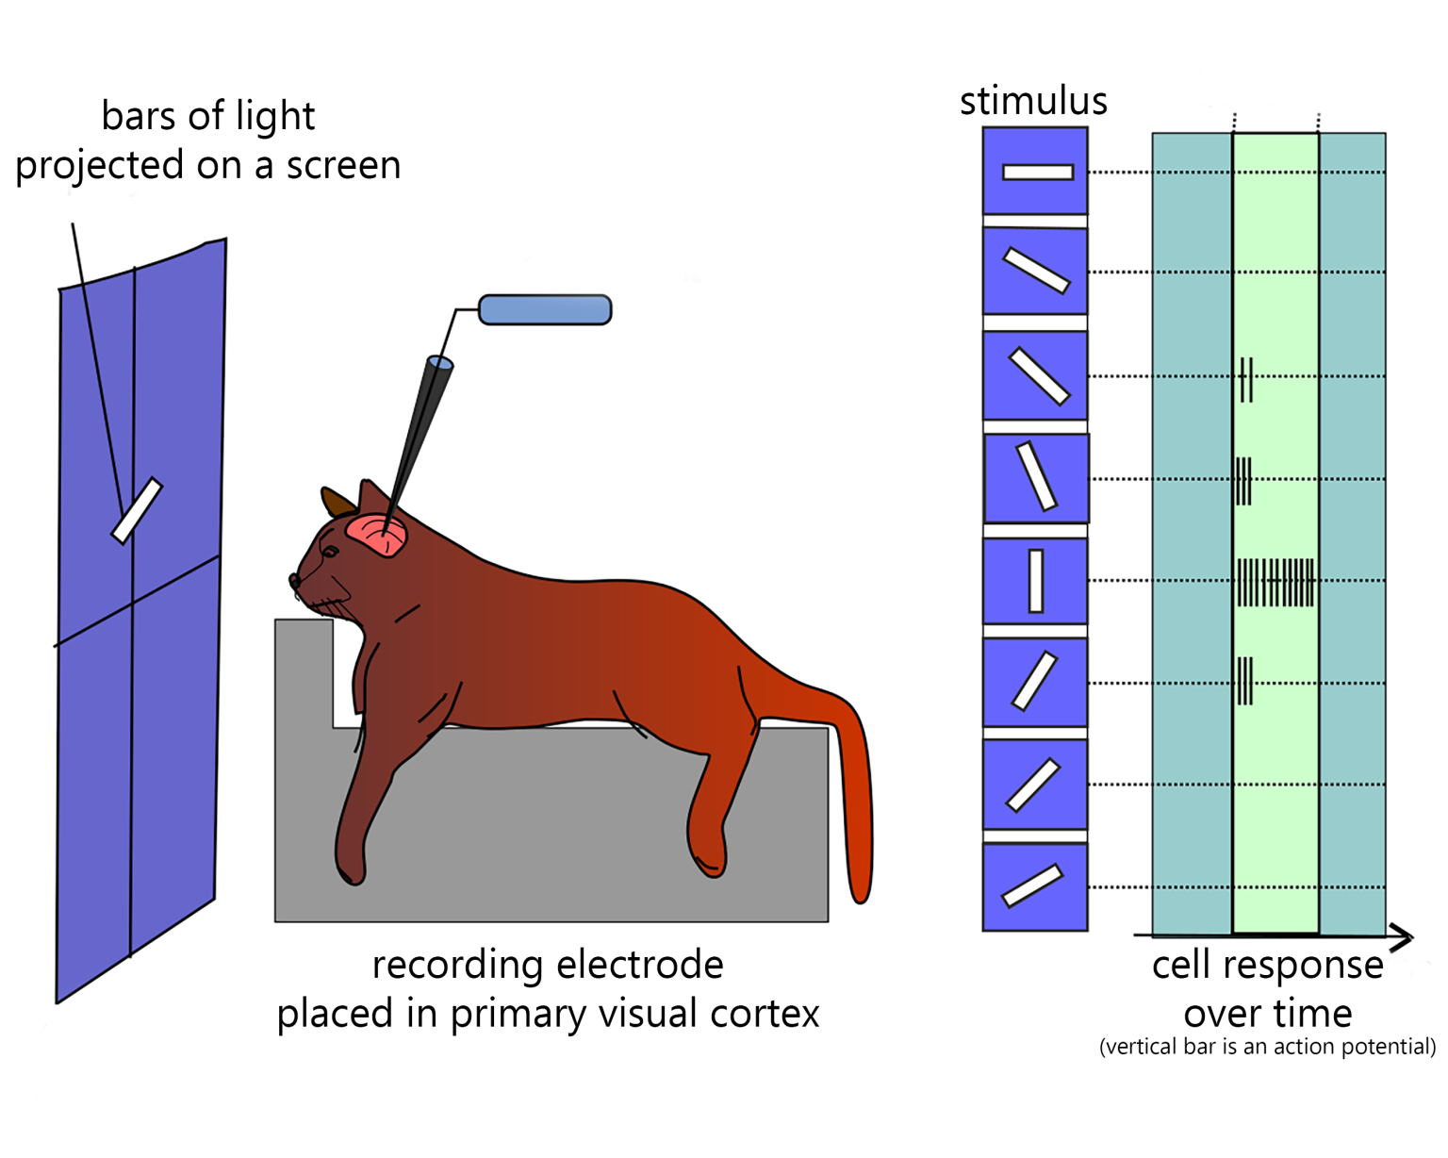
Cat experiment
Some neurons responded to light and dark patterns
Some to vertical bars
Some to horizontal etc…
They named these neurons simple cells
https://upload.wikimedia.org/wikipedia/commons/0/0e/Orientation_V1.svg
Notes:
In one experiment, done in 1959, they inserted a microelectrode into the primary visual cortex of an anesthetized cat.

Slide 9
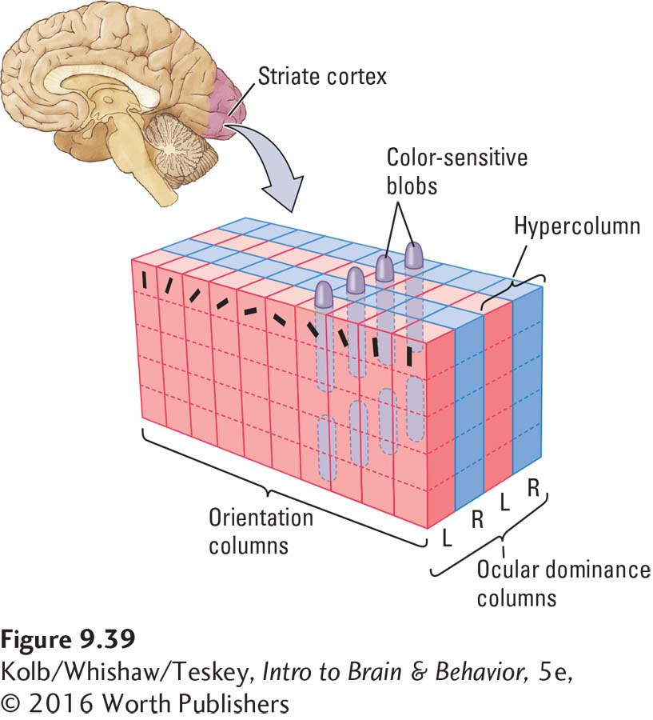
Ocular dominance columns
Laid out in a striped pattern across the surface of the striate cortex (V1)
Respond preferentially to input from one eye or the other
Develop in early childhood
https://digfir-published.macmillanusa.com/kolbintro5e/asset/img_ch9/kolb5e_fig09_39.html
Notes:
Depriving kittens of the use of one eye, column normally receiving input from one eye gets taken over by the other, this is mostly irreversible. Amblyopia in humans (lazy eye)

Slide 10
Implications
Development of the visual system and processing
Discovery of ocular dominance columns
Helped in the development of treatments for childhood cataracts, strabismus and the prevention of deprivation amblyopia.

Slide 11
Take home
Discovery of the functional specialization of the cerebral hemispheres
We now know that most higher functions are located in the right hemisphere, analytical in the left
Discovery of the building blocks of the visual processing system
Discovery of ocular dominance columns and the critical period

Slide 12

Thank you
Robin Herberich
Maguette Diouf

Slide 13
Sources
Images:
https://mcleanit.ca/wp-content/uploads/Brain_picture2.jpg
https://www.nobelprize.org/prizes/medicine/1981/sperry/facts/
https://www.nobelprize.org/prizes/medicine/1981/hubel/facts/
https://www.nobelprize.org/prizes/medicine/1981/wiesel/facts/
https://definingmomentscanada.ca/wp-content/uploads/2022/09/img_EP_hubel-weisel-toys2.jpg
https://upload.wikimedia.org/wikipedia/commons/0/0e/Orientation_V1.svg
https://digfir-published.macmillanusa.com/kolbintro5e/asset/img_ch9/kolb5e_fig09_39.html
press-1-4.gif
images
8HKCZLogTi1BPmZykgYdaA.png
500px-Corpus_callosum.gif
Sources:
https://www.nobelprize.org/prizes/medicine/1981/press-release/
https://definingmomentscanada.ca/nobelcanadian/david-hubel/the-scientist/
https://embryo.asu.edu/pages/roger-sperrys-split-brain-experiments-1959-1968-0
https://en.wikipedia.org/wiki/Split-brain
https://en.wikipedia.org/wiki/Ocular_dominance_column#:~:text=Ocular%20dominance%20columns%20are%20stripes,the%20striate%20cortex%20(V1).

